Slide 1
Java Conditional Statements or Decision Making

Slide 2
Two types of decision making statements in Java
if statements
switch statements

Slide 3
The if statement
An if statement consists of a Boolean expression followed by one or more statements.

Slide 4
Syntax:
If(Boolean expression){
//statements will execute if Boolean expression is true
}

Slide 5
Notes:
If the Boolean expression evaluates to true then the block of code inside the if statement will be executed.
If not the first set of code after the end of the if statement (after the closing curly brace) will be executed.

Slide 6
Example
public class Test {
public static void main(String args[]) {
int x = 10;
if (x < 20) {
System.out.print("This is if statement");
}
}
}

Slide 7
The if...else Statement:
An if statement can be followed by an optional else statement, which executes when the Boolean expression is false.

Slide 8
Syntax
if(Boolean_expression){
//Executes when the Boolean expression is true
}else{
//Executes when the Boolean expression is false
}

Slide 9
Example to find smallest of two numbers
int x = 100;
int y = 20;
if(x<y){
System.out.println("X is small");
}else{
System.out.println("Y is small");
}

Slide 10
Example
public class Test {
public static void main(String args[]) {
int x = 30;
if (x < 20) {
System.out.print("This is if statement");
} else {
System.out.print("This is else statement");
}
}
}

Slide 11
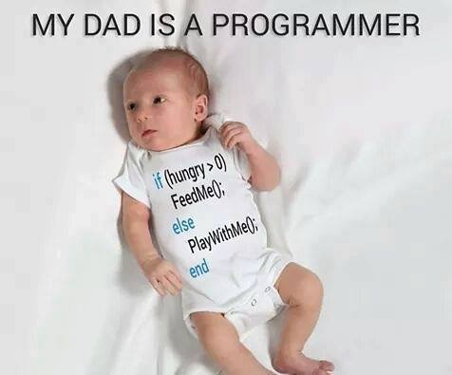

Slide 12
If block with or without curly braces
If(false){
System.out.println(“if statement 1”);
System.out.println(“if statement 2”);
}
If(false)
System.out.println(“if statement 1”);
System.out.println(“if statement 2”);

Slide 13
The if...else if...else Statement:
An if statement can be followed by an optional else if...else statement, which is very useful to test various conditions using single if...else if statement.
When using if , else if , else statements there are few points to keep in mind.
An if can have zero or one else's and it must come after any else if's.
An if can have zero to many else if's and they must come before the else.
Once an else if succeeds, none of the remaining else if's or else's will be tested.

Slide 14
Syntax
Syntax:
if(Boolean_expression 1){
//Executes when the Boolean expression 1 is true
}else if(Boolean_expression 2){
//Executes when the Boolean expression 2 is true
}else if(Boolean_expression 3){
//Executes when the Boolean expression 3 is true
}else {
//Executes when the none of the above condition is true.
}

Slide 15
Example
public class Test {
public static void main(String args[]){
int x = 30;
if( x == 10 ){
System.out.print("Value of X is 10");
}else if( x == 20 ){
System.out.print("Value of X is 20");
}else if( x == 30 ){
System.out.print("Value of X is 30");
}else{
System.out.print("This is else statement");
}
}
}

Slide 16
Program to find biggest of 3 numbers
Way 1 – only ifs
Way 2 - Nested If
int x = 100;
int y = 50;
int z = 200;
if (x > y && x > z) {
System.out.println(" X is big");
}
if (y > x && y > z) {
System.out.println(" Y is big");
}
if (z > x && z > y) {
System.out.println(" Z is big");
}
if (x > y) {
if (x > z) {
System.out.println(" X is big");
}
}
if (y > x) {
if (y > z) {
System.out.println(" Y is big");
}
}
if (z > x) {
if (z > y) {
System.out.println(" Z is big");
}
}

Slide 17
Program to find biggest of 3 numbers
Way 3 – if..else if
Way 4 – if.. else if.. else
if(x>y && x>z){
System.out.println(" X is big");
}else if(y>x && y>z){
System.out.println(" y is big");
}else if(z>x && z>y){
System.out.println(" z is big");
}
if(x>y && x>z){
System.out.println(" X is big");
}else if(y>z){
System.out.println(" y is big");
}else{
System.out.println(" z is big");
}

Slide 18
Nested if...else Statement:
It is always legal to nest if-else statements which means you can use one if or else if statement inside another if or else if statement.

Slide 19
Syntax
if(Boolean_expression 1){ //outer if block
//Executes when the Boolean expression 1 is true
if(Boolean_expression 2){ //inner if block
//Executes when the Boolean expression 2 is true
}
}

Slide 20
Example
public class Test {
public static void main(String args[]){
int x = 30;
int y = 10;
if( x == 30 ){
if( y == 10 ){
System.out.print("X = 30 and Y = 10");
}
}
}
}

Slide 21
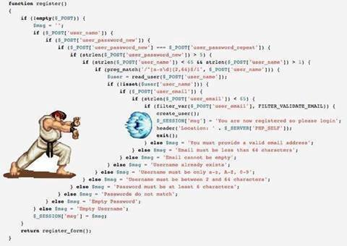
Nested if

Slide 22
The switch Statement:
A switch statement allows a variable to be tested for equality against a list of values. Each value is called a case, and the variable being switched on is checked for each case.

Slide 23
Syntax
switch(expression){
case value :
//Statements
break; //optional
case value :
//Statements
break; //optional
//You can have any number of case statements.
default : //Optional
//Statements
}

Slide 24
The following rules apply to a switch statement:
The variable used in a switch statement can only be a byte, short, int, or char.
You can have any number of case statements within a switch. Each case is followed by the value to be compared to and a colon.
The value for a case must be the same data type as the variable in the switch and it must be a constant or a literal.
When the variable being switched on is equal to a case, the statements following that case will execute until a break statement is reached.
When a break statement is reached, the switch terminates, and the flow of control jumps to the next line following the switch statement.
Not every case needs to contain a break. If no break appears, the flow of control will fall through to subsequent cases until a break is reached.
A switch statement can have an optional default case, which must appear at the end of the switch. The default case can be used for performing a task when none of the cases is true. No break is needed in the default case.

Slide 25
Grades Using If.. else if..else
public class GradeExampleWithIf {
public static void main(String[] args) {
char ch = 'E';
if(ch=='A'){
System.out.println("Excellent");
}else if(ch=='B' || ch=='C'){
System.out.println("Good");
}else if(ch=='D'){
System.out.println("Pass");
}else if(ch=='E'){
System.out.println("Fail");
}else{
System.out.println("invalid character");
} }}

Slide 26
Grades Using Switch
public class GradingSystemUsingSwith {
public static void main(String[] args) {
char ch= 'A';
switch (ch) {
case 'A':
System.out.println("Excellent");
break;
case 'B':
System.out.println("Good");
break;
case 'C':
System.out.println("Good");
break;
case 'D':
System.out.println("Passed");
break;
case 'E':
System.out.println("Fail");
break;
default:
System.out.println("Invalid character");
break;
}}}

Slide 27
Quiz

Slide 28
Queries

